Slide 1

What Machine Learning?
Machine Learning, often abbreviated as ML, is a subset of artificial intelligence (AI) that focuses on the development of computer algorithms that improve automatically through experience and by the use of data. In simpler terms, machine learning enables computers to learn from data and make decisions or predictions without being explicitly programmed to do so.
References: https://www.datacamp.com/blog/what-is-machine-learning

Slide 2

What are the three types of machine leaning that you should known?

Slide 3
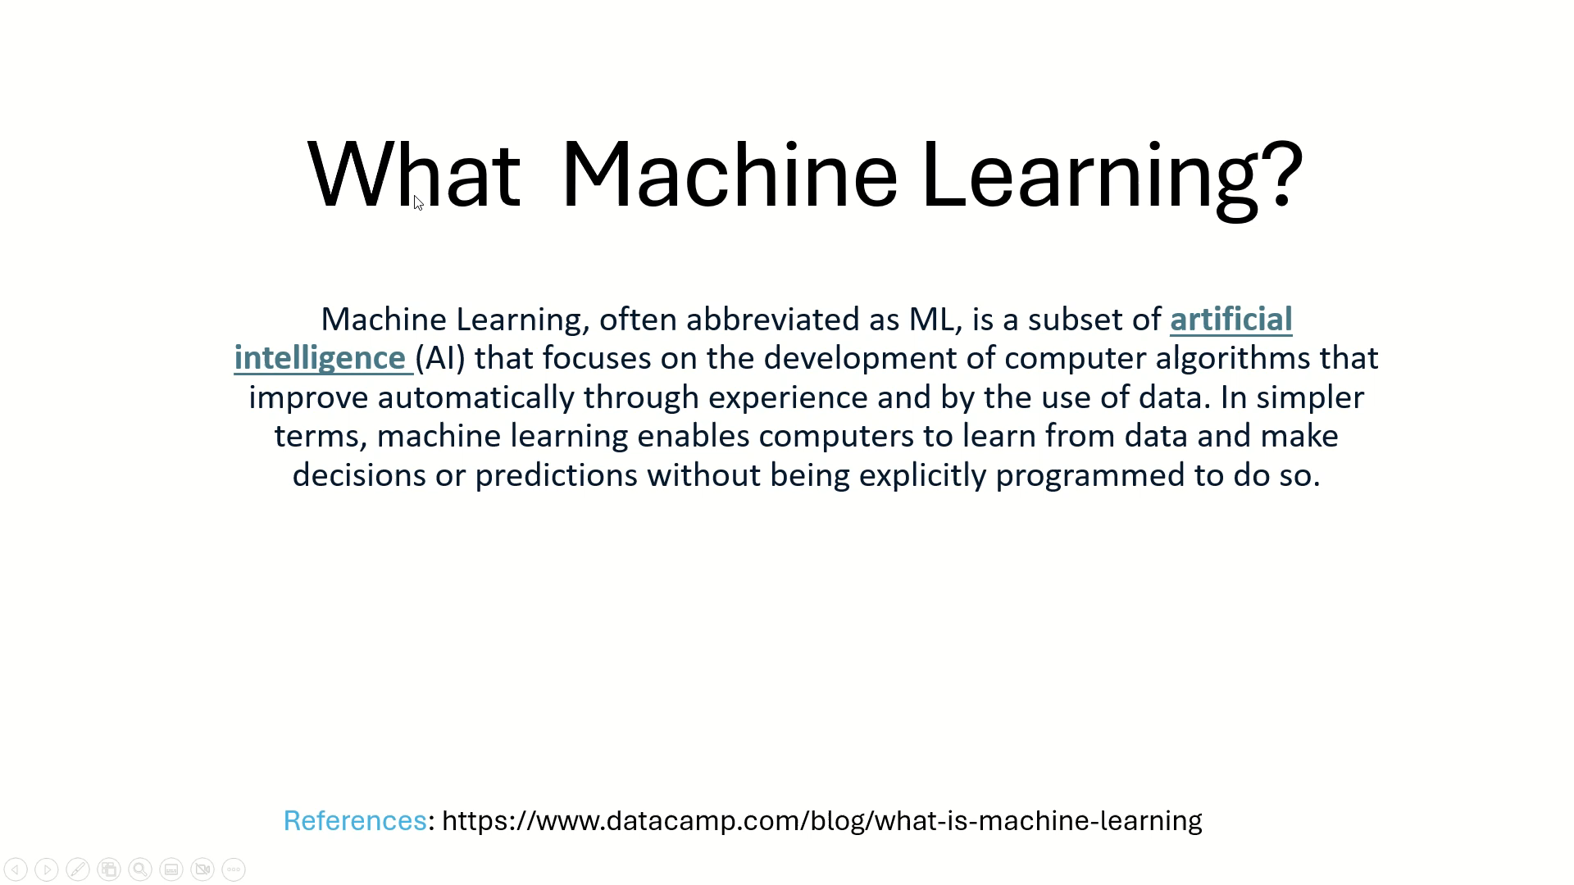
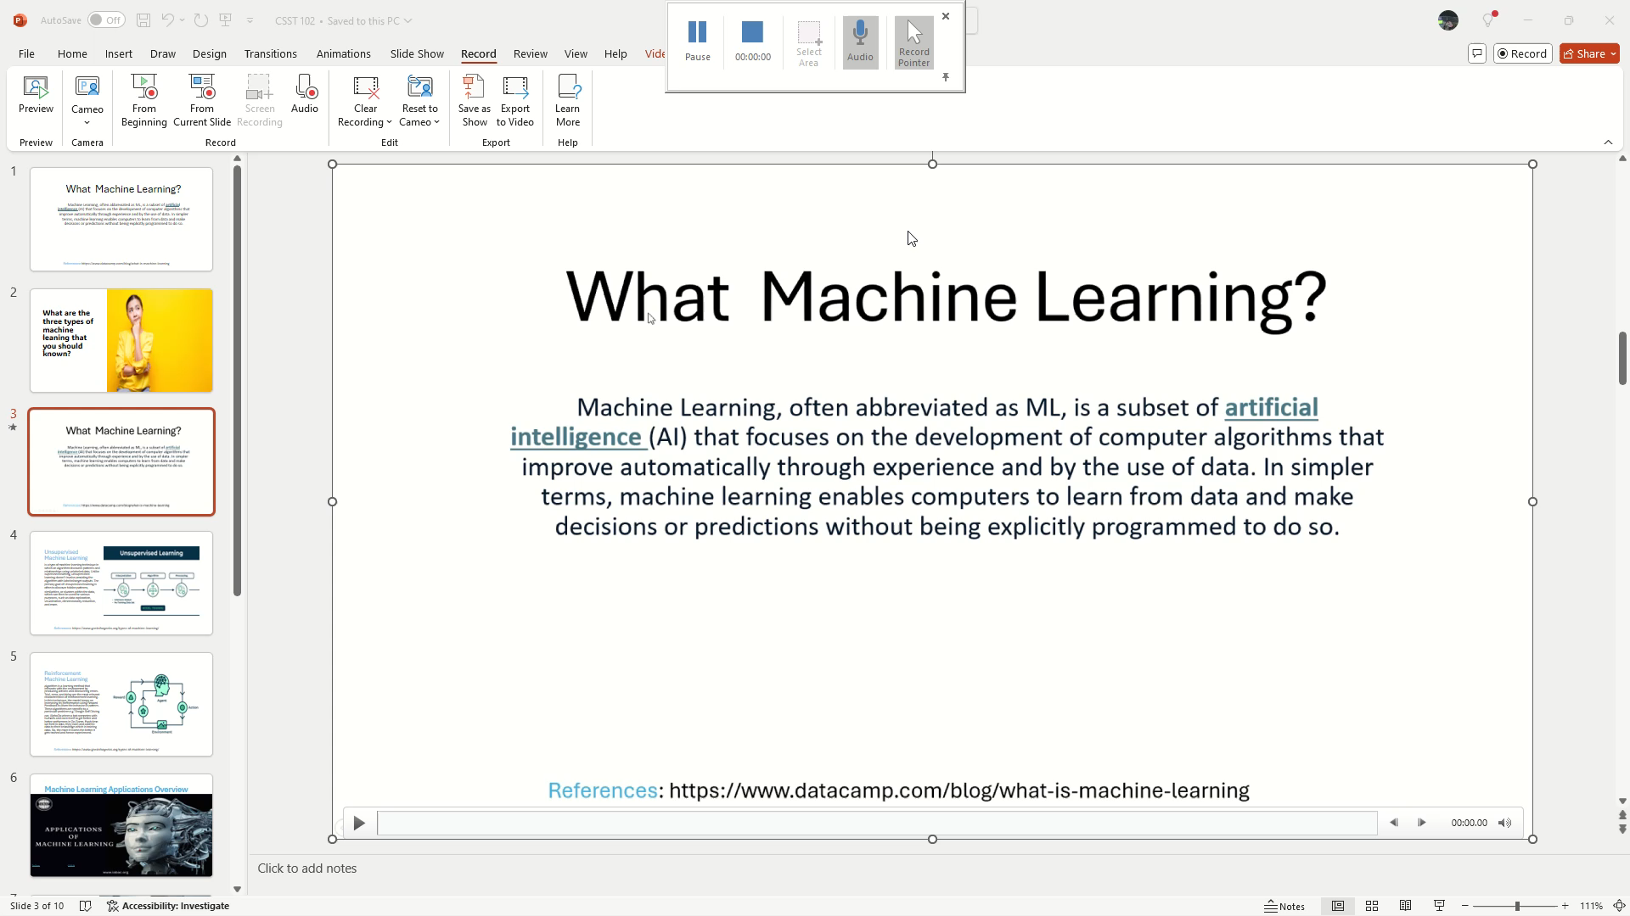
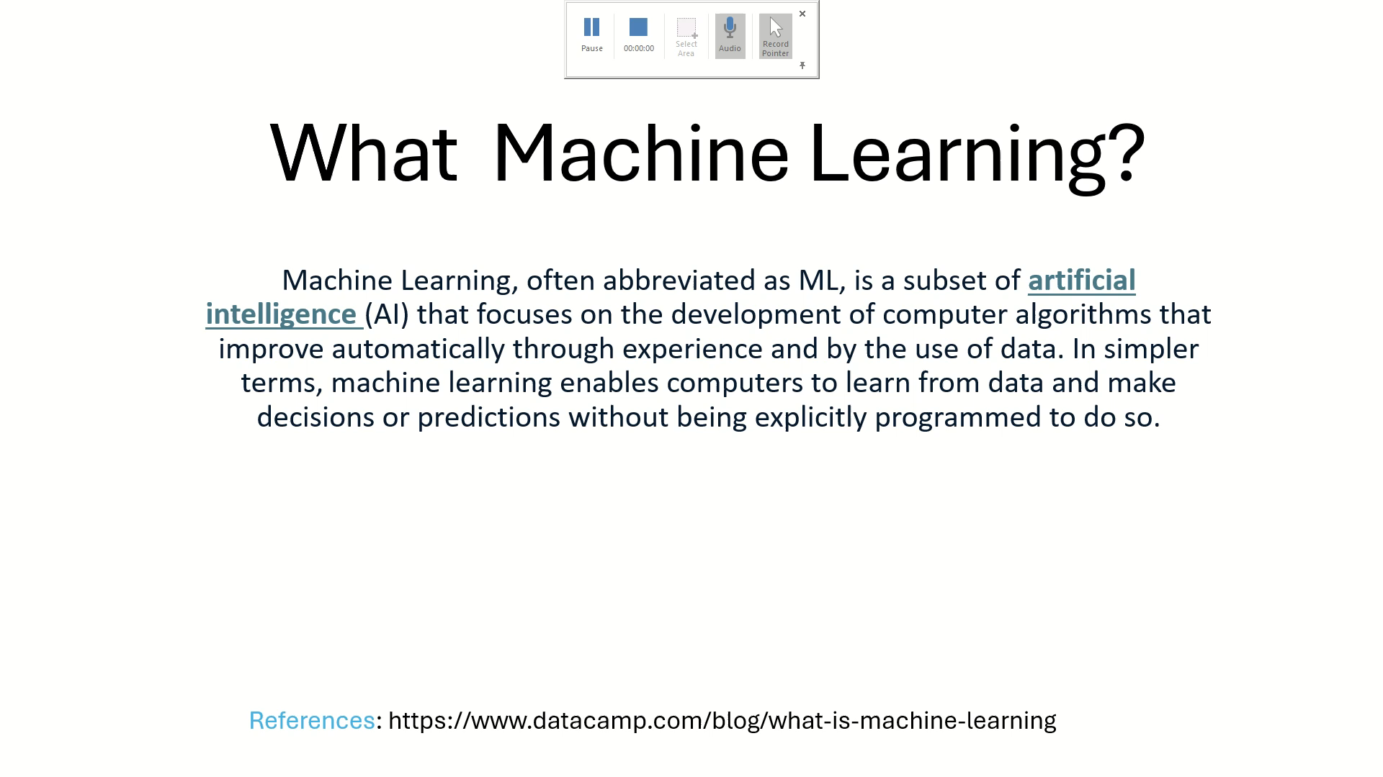
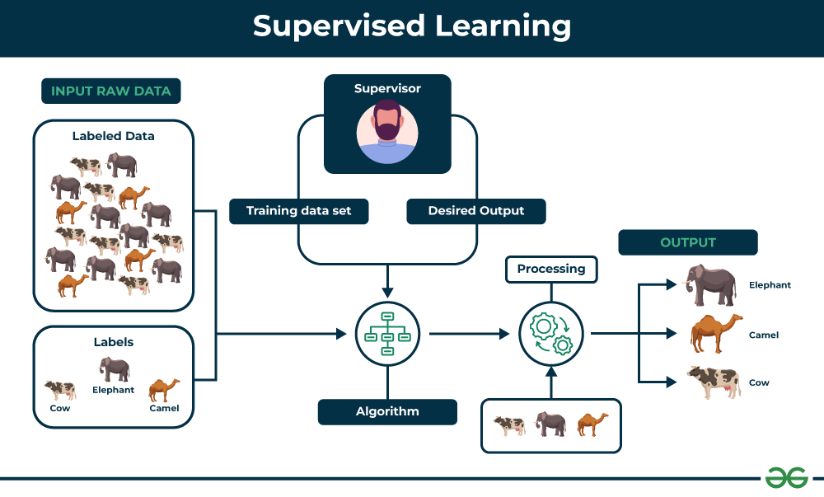
Supervised Learning
is defined as when a model gets trained on a “Labelled Dataset”. Labelled datasets have both input and output parameters. In Supervised Learning algorithms learn to map points between inputs and correct outputs. It has both training and validation datasets labelled.
References: https://www.geeksforgeeks.org/types-of-machine-learning/

Slide 4
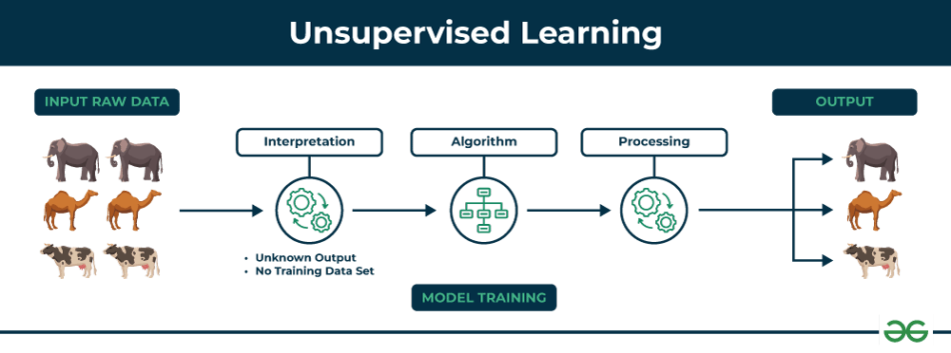
Unsupervised Machine Learning
is a type of machine learning technique in which an algorithm discovers patterns and relationships using unlabeled data. Unlike supervised learning, unsupervised learning doesn’t involve providing the algorithm with labeled target outputs. The primary goal of Unsupervised learning is often to discover hidden patterns, similarities, or clusters within the data, which can then be used for various purposes, such as data exploration, visualization, dimensionality reduction, and more.
References: https://www.geeksforgeeks.org/types-of-machine-learning/

Slide 5
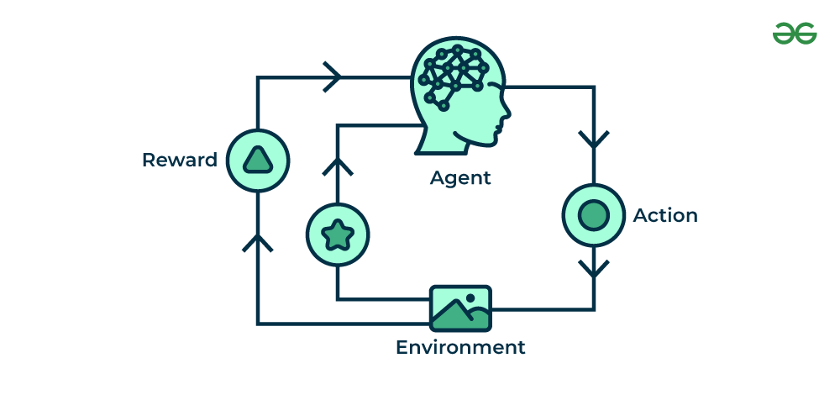
Reinforcement Machine Learning
algorithm is a learning method that interacts with the environment by producing actions and discovering errors. Trial, error, and delay are the most relevant characteristics of reinforcement learning. In this technique, the model keeps on increasing its performance using Reward Feedback to learn the behavior or pattern. These algorithms are specific to a particular problem e.g. Google Self Driving car, AlphaGo where a bot competes with humans and even itself to get better and better performers in Go Game. Each time we feed in data, they learn and add the data to their knowledge which is training data. So, the more it learns the better it gets trained and hence experienced.
References: https://www.geeksforgeeks.org/types-of-machine-learning/

Slide 6

Machine Learning Applications Overview
This Photo by Unknown Author is licensed under CC BY-SA

Slide 7
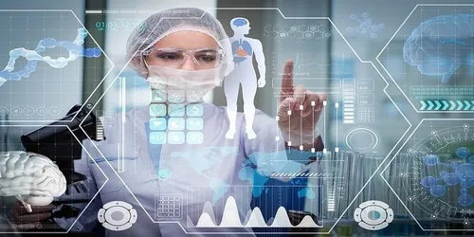
Healthcare: Drug Discovery & Manufacturing
The problem that solved: Machine learning applications have found their way into the field of drug discovery, especially in the preliminary stage, right from the initial screening of a drug’s compounds to its estimated success rate based on biological factors. This is primarily based on next-generation sequencing.
Unsupervised Learning: Machine Learning is being used by pharma companies in the drug discovery and manufacturing process. However, at present, this is limited to using unsupervised ML that can identify patterns in raw data. The focus here is to develop precision medicine powered by unsupervised learning, which allows physicians to identify mechanisms for “multifactorial” diseases. The MIT Clinical Machine Learning Group is one of the leading players in the game.
Impact of the solution: Its precision medicine research aims to develop such algorithms that can help to understand the disease processes better and accordingly chalk out effective treatment for health issues like Type 2 diabetes.

Slide 8

Finance: Fraud Detection
The problem that solved: Real-time fraud detection in finance involves monitoring transactions as they occur, using advanced algorithms to analyze data instantly, and blocking fraudulent activity before it can cause financial harm.
Machine Learning Types:
Unsupervised & Supervised Learning Machine learning in fraud detection uses algorithms to analyze transaction patterns and flag unusual behavior that might indicate fraud, improving the accuracy and speed of detecting suspicious activities.
Solution Impact: Machine learning has transformed finance by improving decision-making, managing risk better, and increasing efficiency through predictive analytics, fraud detection, algorithmic trading, more accurate credit scoring, and enhanced customer service.

Slide 9

Marketing: Product Recommendation
The problem solved: In product recommendation, machine learning solves the problem of delivering personalized suggestions by analyzing user behavior, preferences, and purchase history. This helps businesses provide relevant product recommendations, increasing customer satisfaction and sales.
Machine learning Types: Supervised & Unsupervised Learning
Clustering models
Regression
User-based k-nearest neighbors
Matrix factorization
Bayesian networks
Impact of solution: Enhanced Personalization: Machine learning has revolutionized product recommendation systems by enabling them to automatically learn and improve over time based on user feedback and data. This leads to more accurate and personalized suggestions, increasing user engagement and satisfaction

Slide 10
References
https://search.brave.com/images?q=impact%20of%20machine%20learning%20%20in%20product%20recommendation%3F
https://search.brave.com/search?q=impact+of+machine+learning++in+product+recommendation%3F&source=web&summary=1&summary_og=66d109429ea1299293ffc4
https://search.brave.com/search?q=machine+learning+use+in+product+recommendation%3F&source=desktop&summary=1&summary_og=de9f35e02c2dbdbba987a4
https://www.coursera.org/articles/machine-learning-in-finance
https://www.upgrad.com/blog/machine-learning-applications-in-healthcare/
:

